Slide 1


Joystick controlled wireless robot
Lukas, Karl, Magne, Rasmus, Alexander og Nikolai

Slide 2
Introduction
Concept and Objective
Solution
Movement control
- Speed adjustment
Controller
- LED’s, OLED, Joystick
Wireless data communication
Killswitch
Joystick class
3D print + PCB
Bluetooth

Slide 3
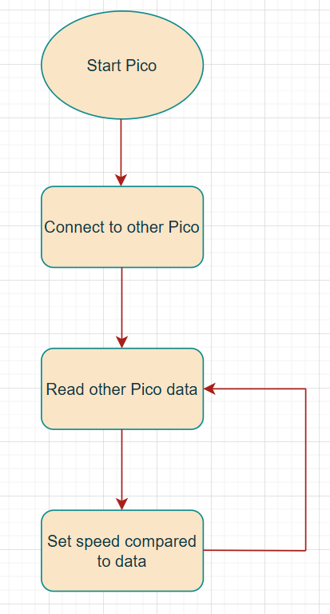
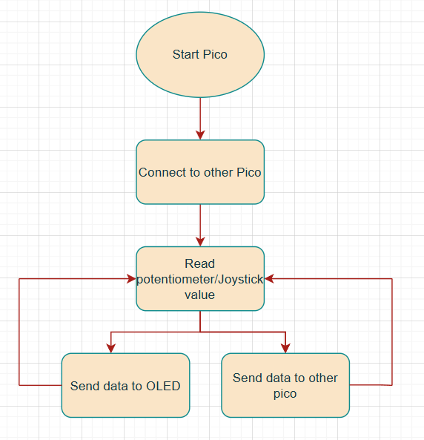
High-level overview

Slide 4
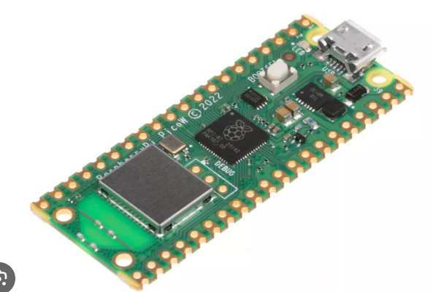
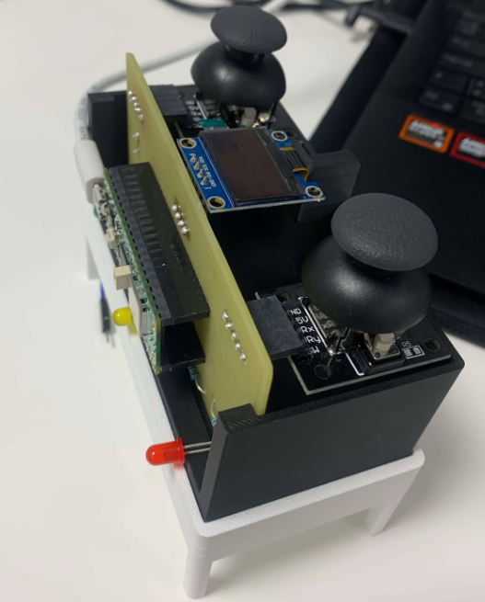
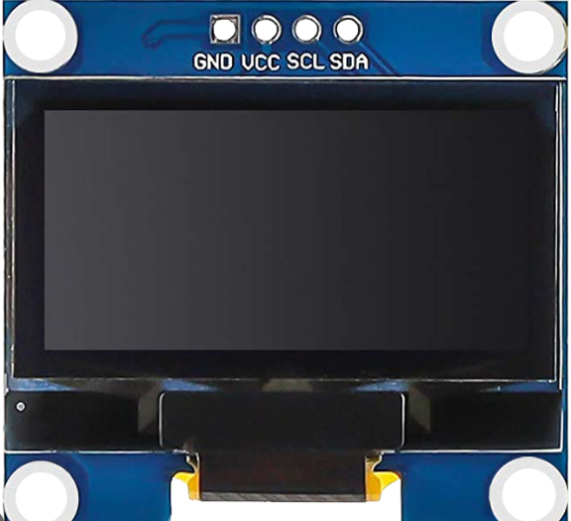
Tools and Materials
Two pico WH’s
PCB
3D print
Killswitch
Joystick
LED
OLED
Resistors (2 Kohm)

Slide 5
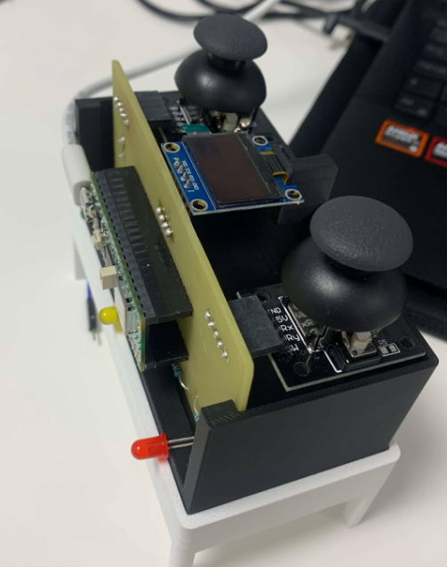
Key features
Killswitch functionality
Joystick/Joystick
Move back -> forward -> left -> right
Wireless Bluetooth communication
OLED and LED integration

Slide 6
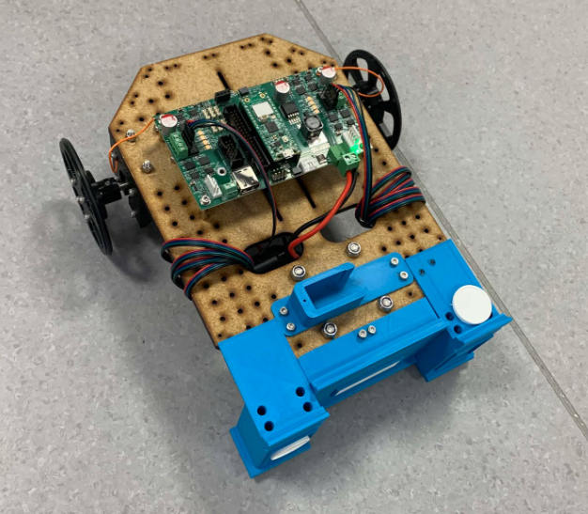
Results
2 picos
Bluetooth
Controller
  Our own print

Slide 7
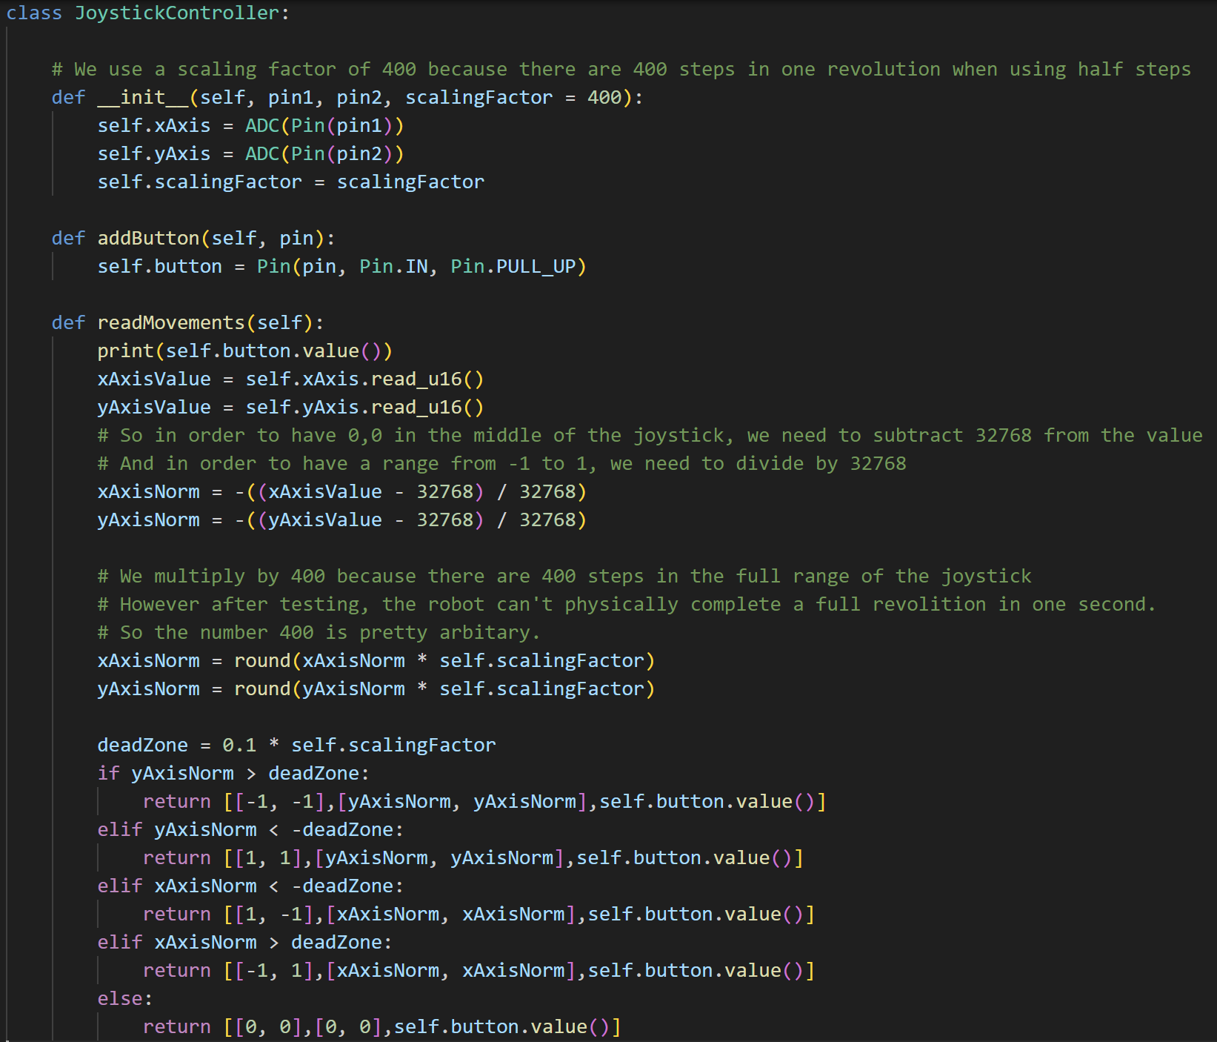
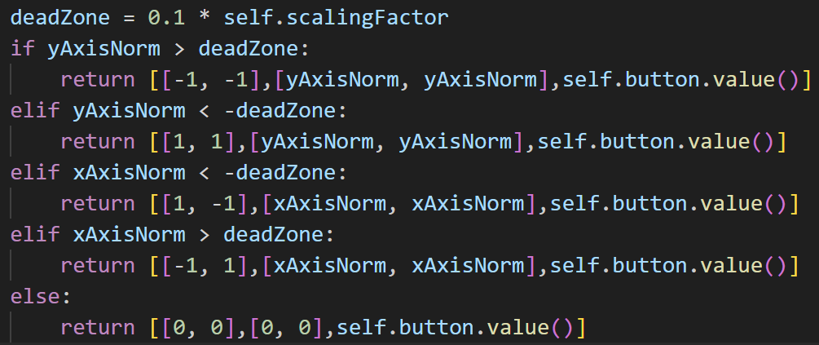
Some of the Code
Joystick

Slide 8
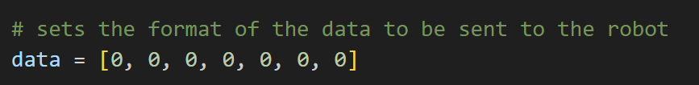
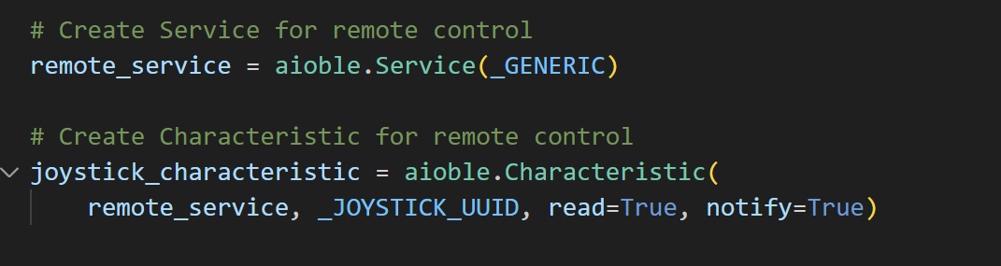
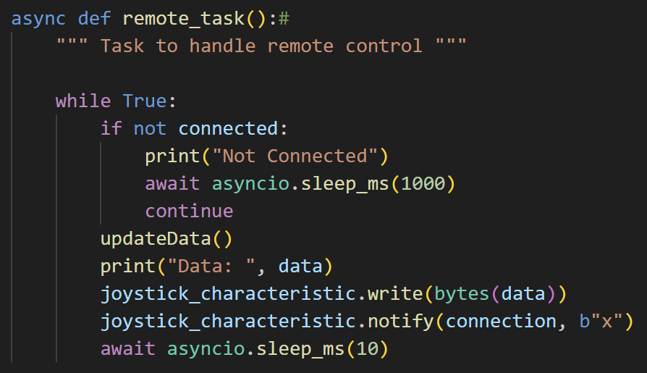
Setup for Bluetooth
Aioble
Services and Characteristics
Packets
  Bytes

Slide 9
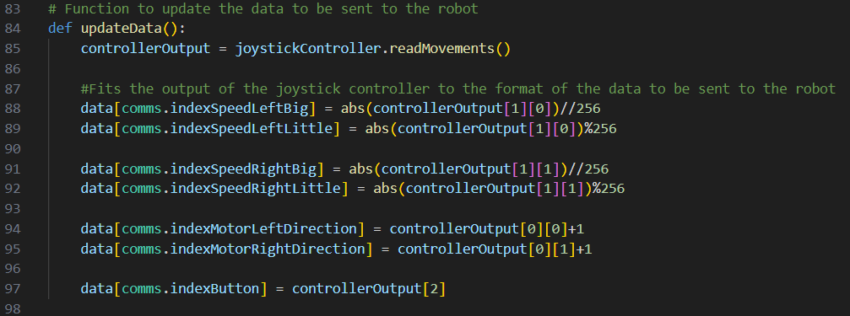
Conversion to bytes
Bluetooth sends uint8
Bytes is 256 different values

Slide 10
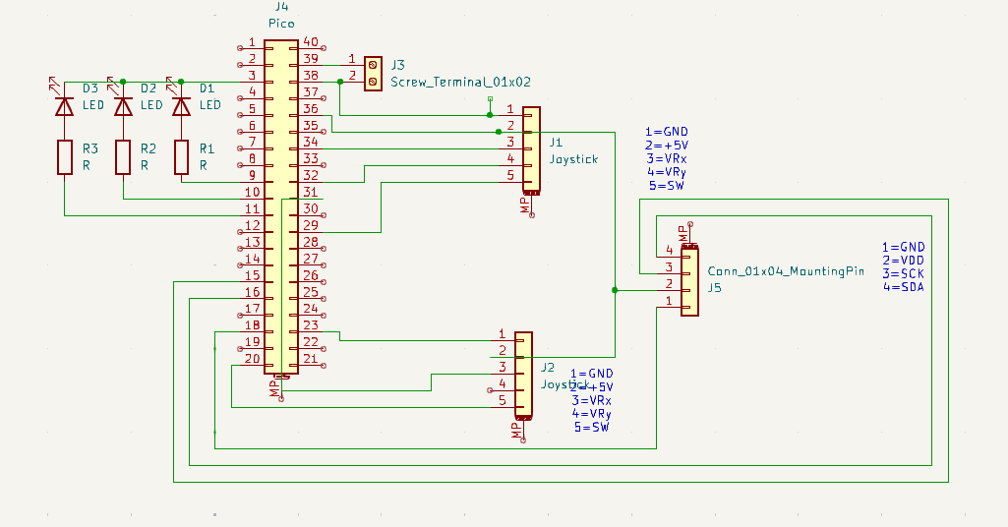
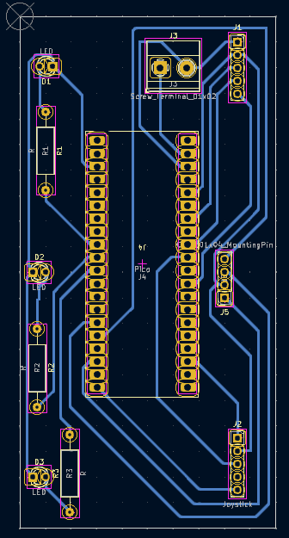
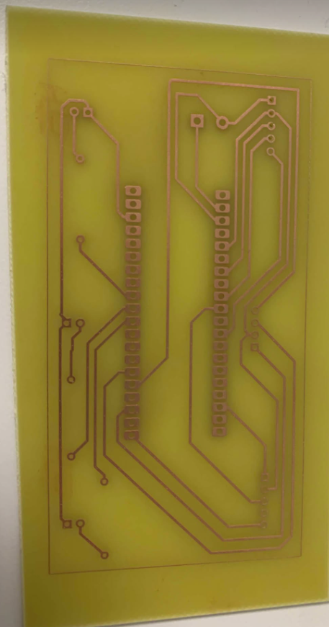
PrintBoard
KiCad
Pico
2 x Joystick – Mounting pin 1x5
OLED – Mounting pin 1x4
Screw terminal
LED – Pre-resitance
Etching​

Slide 11
Demonstration
https://www.youtube.com/watch?v=Fvm5enrU_tU
Springer lige det første min over... da vi står og forklarer

Slide 12
Challenges
PCB soldering issues
Wireless wifi communication or bluetooth

Slide 13

Conclusion and Improvements
Full joystick control left/forward, right/backward etc.
Double joystick integration (too few ADC pins)

